Slide 1
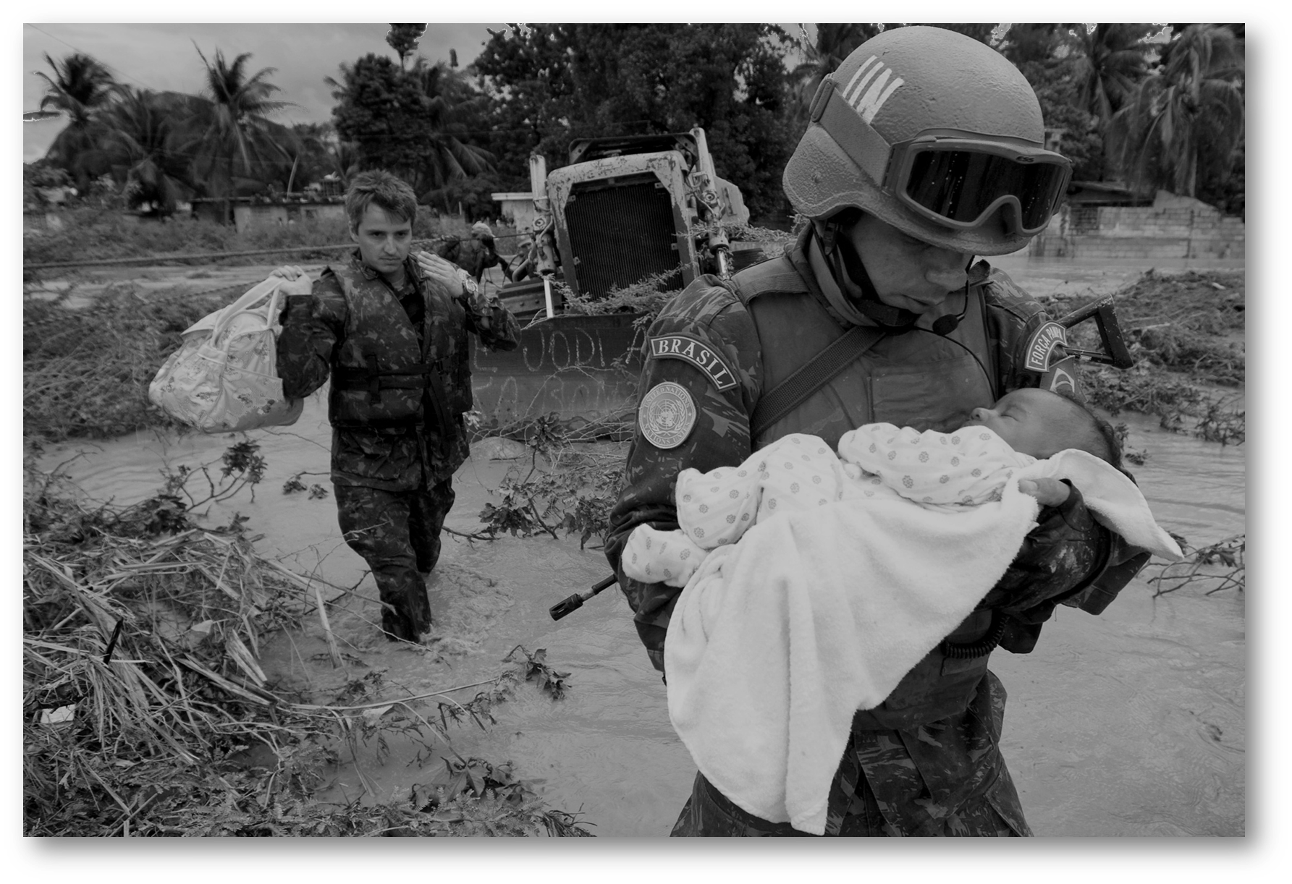
Police
Secondment Campaign – 2023 Phase 1
The workflow process
Serving the World
1

Slide 2
In the presentation:
Background on Secondment Campaigns
Workflow process overview
Job Openings
Submissions
Screening and Short-listing
Assessment and Selection
Successful candidates
Communications

Slide 3
Background
on Secondment Campaigns and process workflow

Slide 4
Background on Secondment Campaigns
A Police “Secondment campaign” is normally conducted once or twice a year depending on available Job Openings (JOs)
The nominated candidates:
must be in active Police Service
if selected, will be required to be officially seconded to the UN
The usual period seconded police officers may serve in posts financed by the support account for peace operations requiring active police service, is two years. A third year can be approved - based on the performance and on the need of the office - by the Hiring Managers. Exceptionally a fourth and final year extension can be approved by the USG DPO.
Nominations of police officers who are currently on secondment to the UN will not be considered.

Slide 5
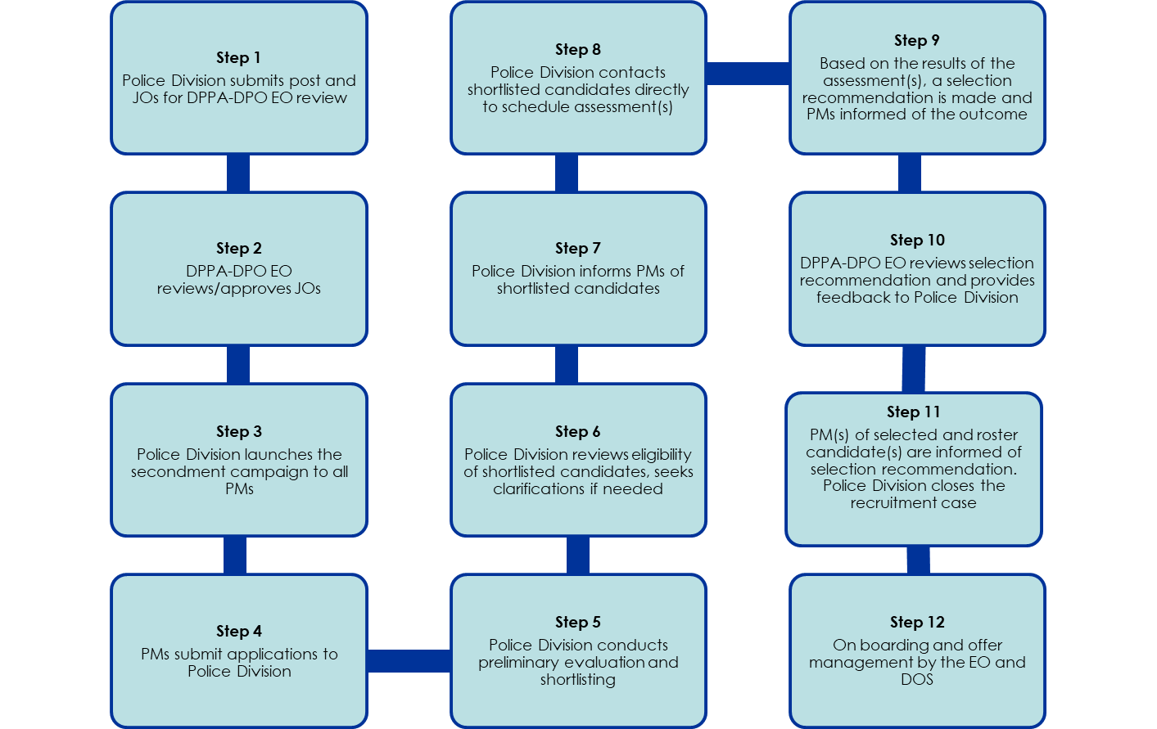
Police Campaign Workflow

Slide 6
Job Openings

Slide 7
Job Openings
Job Openings (JOs) for the Police Secondment Campaign are advertised via a Note Verbale which is sent to all Permanent Missions.
The Note Verbale is distributed by the Police Division by:
E-mail to the generic email of all Permanent Missions in New York as listed in the UN Blue Book;
Email to the focal points in all Permanent Missions, if applicable
JOs in English and French are circulated for 90 days.

Slide 8
Note Verbale
Specifies:
deadline date for application
number of positions available
Includes:
Notification procedures
United Nations Personal History Profile (PHP), P-11
Employment and Academic Certification (Attachment to P-11)
Employment record (Supplementary Sheet)
Excel sheet to list the candidates nominated for each JO
Job Openings in English and French

Slide 9
2023 Police Secondment Campaign – Phase 1
The police posts advertised include 13 JOs for 16 posts:
P-4 Level
Conduct and Discipline Officer, Conduct and Discipline Service
Corrections/Prison Advisory Officer, Policy and Training Team
Training Officer (2 posts), ITS
Police Selection and Recruitment Officer, SRS
UN Police Officer, MMSS
UN Police Officer (Performance), OPA
Police Planning Officer (2 posts), SPDS
Training Officer, OPA
Police Liaison Officer, OPA
P-3 Level
Investigation Officer, OPA
Police Reform Officer, OPA
Training Officer, ITS
UN Police Officer (2 posts), MMSS
9

Slide 10
Submissions

Slide 11
Submission of nominated Candidates
All nominated candidates must be submitted in one single submission via one Note Verbale in accordance with the deadline date of the JO.
Each submission must contain the excel form “Phase 1 of the 2023 Campaign - Application Sheet - List of Candidates by Permanent Missions” duly completed, listing the names and ranks of all the nominated candidates for each JO.

Slide 12
Submission of Nominated Candidates (continuation)
In addition, for each nominated candidate:
A United Nations Personal History Profile (PHP, Form P.11) and if needed an Employment record (Supplementary Sheet), duly completed and signed by the candidate
Employment and Academic Certification (Attachment to Personal History Profile (PHP, Form P.11), duly completed and signed by the candidate and signed, stamped by the relevant local authority indicating the candidate’s graduation from required academic/police institution as well as his/her rank and date of enlistment/entry to service for police officers.

Slide 13
Delivery and Receipt
Submissions must be:
Emailed to dpo-policesecondmentcampaign@un.org
NOTE: No submissions are accepted via ordinary mail or fax or after the deadline.
The designated official/office in the Police Division confirms receipt of the submissions by responding to the electronic submission after verifying that all submission formalities were adhered to.

Slide 14
Screening
&
Shortlisting

Slide 15
Initial Screening
For each submission by a Permanent Mission, the Police Division:
checks that the JO is reflected on the excel sheet form titled “Phase 1 of the 2023 Campaign - Application Sheet - List of Candidates by Permanent Missions”
matches the information on the excel sheet form with the number of nominated candidates received from that Permanent Mission

Slide 16
Initial Screening (continuation)
For each JO, the Police Division completes the following:
reviews the documentation for each nominated candidate to ensure that all the required forms are duly completed and signed, and that the Employment and Academic Certification is attached
records all information into Nova, the HR system used to manage the police recruitment campaign.
provides substantive offices/sections with access to JOs and to candidates for the preliminary evaluation and short-listing.

Slide 17
Preliminary Evaluation & Shortlisting
Once Hiring Managers in the Police Division receive and record all applicants, they:
Conduct a preliminary evaluation of the education, work experience and knowledge of languages of all nominees.
Determine the shortlists.
Inform the respective Permanent Missions of the status of their candidates.

Slide 18
Assessment
&
Selection

Slide 19
Substantive Assessment – written test
Upon confirmation that the shortlisted candidates meet the required qualifications of the JOs, the Hiring Managers in the Police Division proceed with the substantive assessment(s).
Short-listed candidates will be approached directly for scheduling of written test, if required, and of an interview.
Assessment Panels are normally composed of three members, with two being subject matter experts at the same or higher level of the JO, and at least one being female.
19

Slide 20
Substantive Assessment (continuation)
Substantive assessment methods may include a technical test, a written exercise, a case study, a presentation, a simulation exercise, an essay exercise, or another exercise to measure a particular set of skills commensurate with the position, followed by a competency-based interview.
Assessment exercises are conducted in strict confidence.
20

Slide 21
Substantive Assessment - Competency-Based Interview
Short-listed candidates are contacted directly to schedule an interview.
Candidates are notified at least five working days in advance.
The invitation includes the date and time and means of the interview (telephone, video conference, face-to-face).
A separate presentation/link provides details on competency-based interviews and tips on how to prepare.

Slide 22
Recommendations
Following the substantive assessment of the shortlisted candidates, recommendations are submitted to the USG DPO (for posts at the D-1 level and above) by the Hiring Manager in coordination with the Executive Office of DPPA-DPO. For posts up to and including the P-5 level, the Police Adviser has the delegated authority.
Effective from the 1st Phase of the Military/Police Campaign 2011, cases are no longer submitted to the Central Review Bodies.

Slide 23
Selection Decisions
Selection decisions for each JO are approved by the Under-Secretary-General of DPO.
Once a selection decision is made:
A fax/NV is sent from the Police Division to the Permanent Mission, to notify that their candidate was either recommended for selection, recommended for the roster for a period of two years, or was not successful.
The official offer of appointment is sent to the candidate from OHR/DOS.
At the end of a campaign, the Permanent Mission will be provided with the consolidated results for all JOs of their recommended candidates.

Slide 24
Successful Candidates

Slide 25
Terms of Appointments
Effective from Phase I, Military/Police Campaign-2011 selected candidates:
Are issued fixed-term appointments for a period of two years limited to service on posts financed by the support account for peacekeeping operations requiring active military/police service;
Are considered external candidates when applying to other UN civilian JOs.
Seconded officers who apply to civilian JOs at the professional level within the Organization must meet all academic and experience requirements as listed in the JO.

Slide 26
Background Checks
Effective from Phase II of the 2011 Military and Police Campaign:
Background checks for selected candidates are not performed by OHR – this information is now certified on the Employment and Academic Certification form by the relevant local authority of Member States.
All seconded officers who apply to civilian JOs at the professional level within the Organization will be subject to background checks on par with other applicants.

Slide 27
Communications

Slide 28
Communication regarding a Police Campaign is done through the Permanent Missions only.
Queries from recommended candidates are not entertained.
For each Police Campaign the contact information of the key focal point/office in the Police Division will be provided to Member States.

